Slide 1



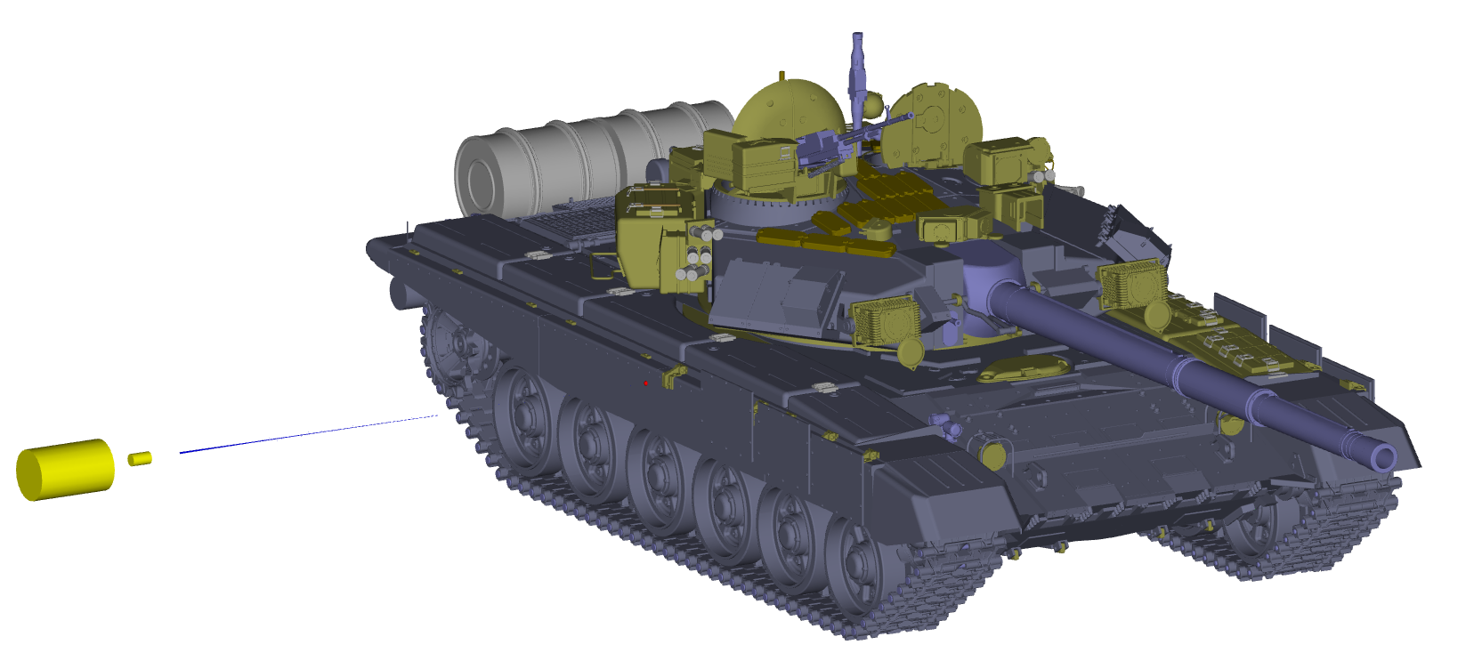
Uniquely Specialized in
Simulation Software and Engineering Services
MAP-SC
Modular Analysis Package
for
Shaped Charge Analysis

Slide 2

What is MAP?
MAP (Modular Analysis Package) is a „unit assembly system“ for customized weapons effects (WE) and lethality / vulnerability (L/V) codes.
blast loads
kill
probability
fault-tree
processor
terminal ballistics
fly-out
analysis
opti-mization
Tailored software solutions are assembled from existing functional modules and adaped to customers‘ specific requirements
relatively short project time
tested and proven models
Further modules can be added if the functional requirements change
high flexibility and adaptivity for future demands

Slide 3
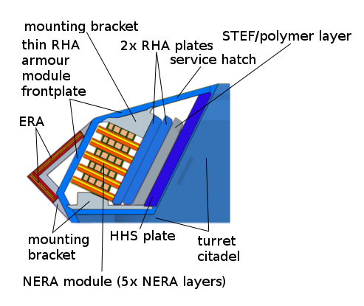
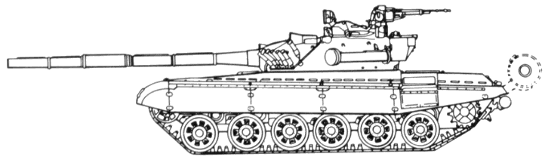
Motivation for MAP-SC
3
Analyze terminal ballistics effects of several SC warheads into armor systems
Modern armor consists of different materials
and often include complex systems

Slide 4
Motivation for MAP-SC
Analyze terminal ballistics effects of several SC warheads into armor systems
Combine available models for different aspects into one complete software program
Threat modeling of the shaped charges including the stochastic effects
(e.g. jet stretching, jet breakup, particle drift and rotation),
Terminal ballistics modeling of the SC jet with the main armor evaluating
the penetration depth and the crater geometry caused by the jet particles,
Terminal ballistics modeling with ERA plates including ERA initiation,
ERA plate acceleration and interaction of the ERA plates with the SC jet,
Behind armor debris modeling considering the exit of the jet particles and
the detaching of the armor material at the rear surface.
Notes:
Zeile: We have a project where we should analyze and evaluate the TB effects of several SC warheads into armor systems. As examples, warheads were Tandem Shaped Charges and armor systems consists of complex ERA and main armor.
Zeile: Our challenge was to combine available models we already developed in the past into one complete software program.
The physical process which have to be considered in the program are
Threat vorlesen
Terminal ballistics of SC with main armor vorlesen
Terminal ballistics with ERA
Behind armor debris vorlesen
The four points are directly the outline of my üresentation

Slide 5
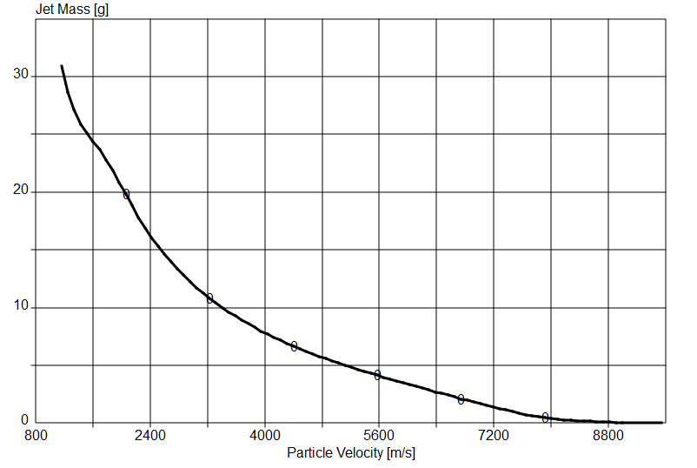
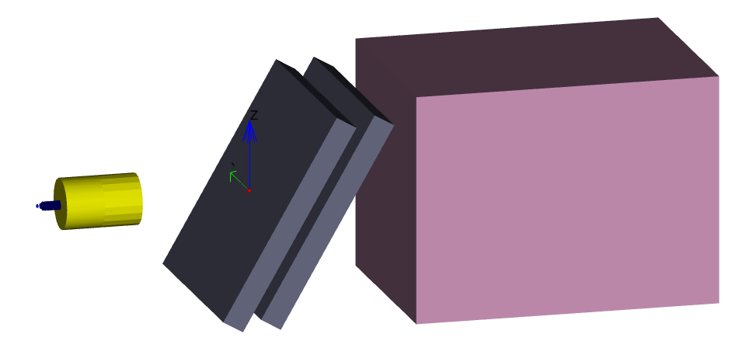
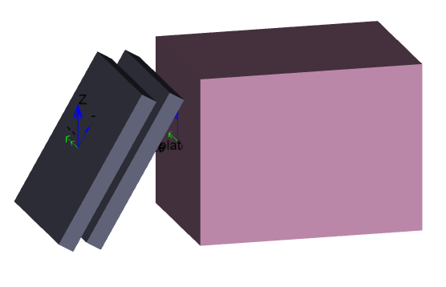
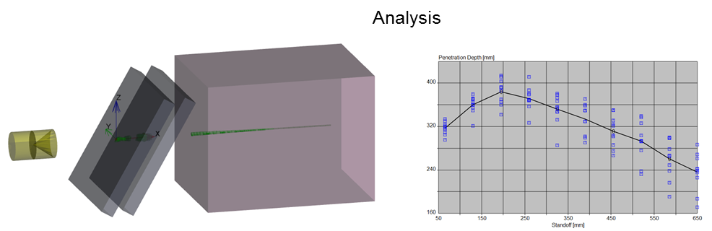
General Approach
Target and threat model are set up independently and combined in a scenario that is analysed in a calculation module.
Scenario setup
Effector modeling
Target modeling

Slide 6
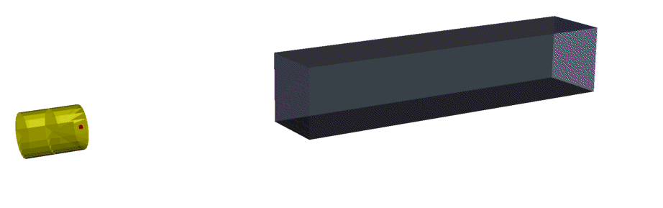
General Approach
Combination of (semi-)analytical models for individual shaped charge and terminal ballistics processes.
Jet characteristics
Jet stretching and breakup model
Jet / particle drift and particle rotation model
Penetration model
Crater model
Particle – crater wall interaction

Slide 7
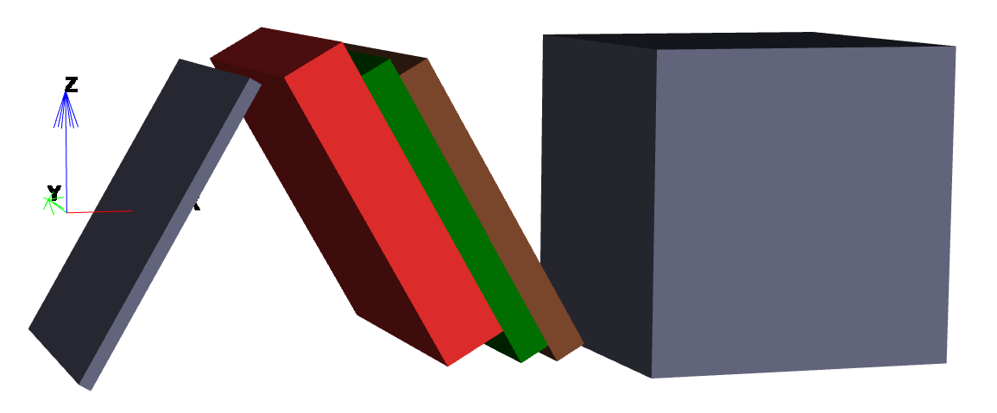
Target Model
In the MAP-SC basic version, target structures are modeled as an array of plates or blocks.

Slide 8
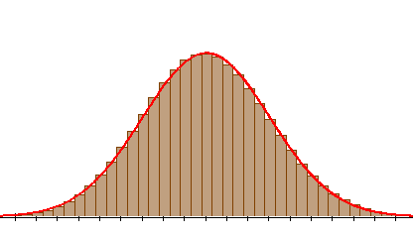
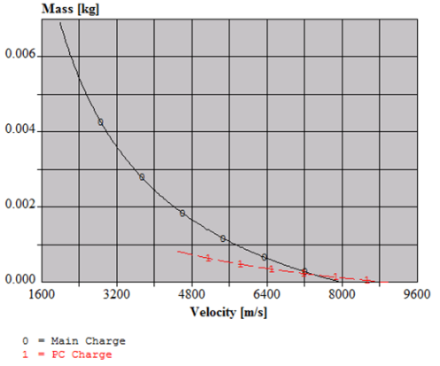
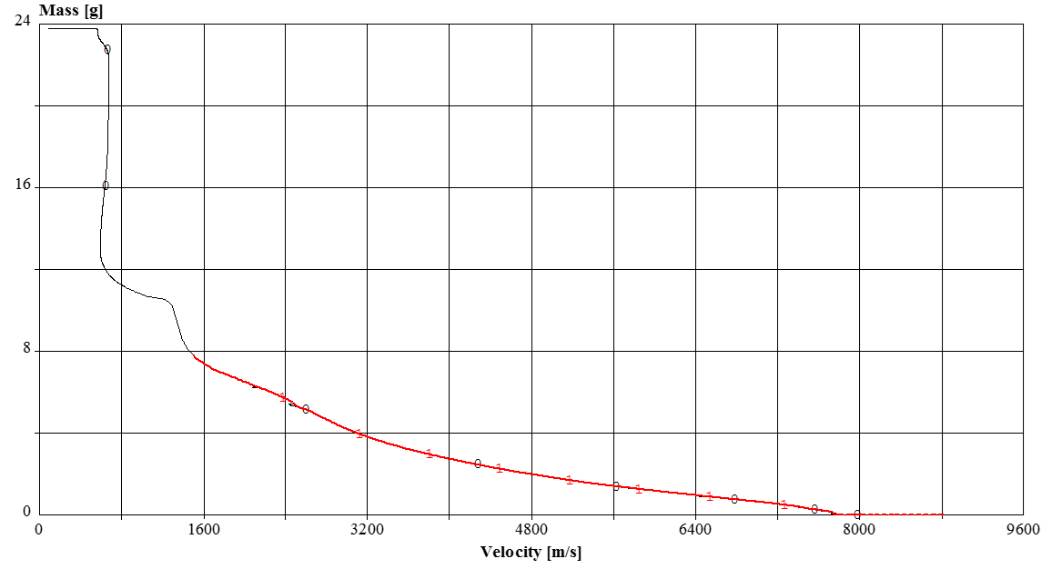

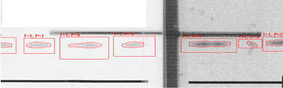
Shaped Charge Model
Different types of SC
modeling are available
uncertainties
Threat Model
from hydrocode
(SPEED interface with multi-jet capability)
from analytical function
from experiments
(optional)

Slide 9
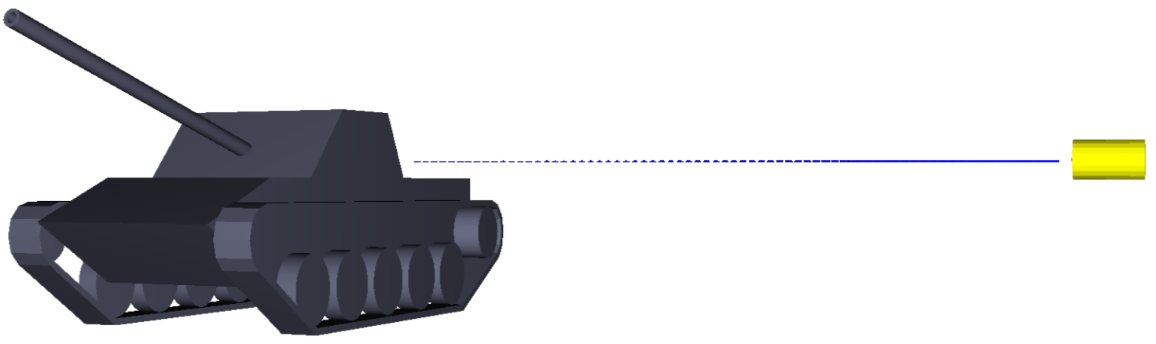


Scenario
The encounter / endgame situation is defined separately in a scenario.
Parameters
threat / target position
threat / target velocity
pitch, yaw, roll
analysis settings
…
Scenario

Slide 10
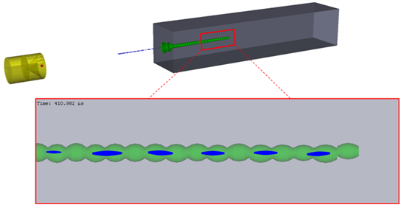
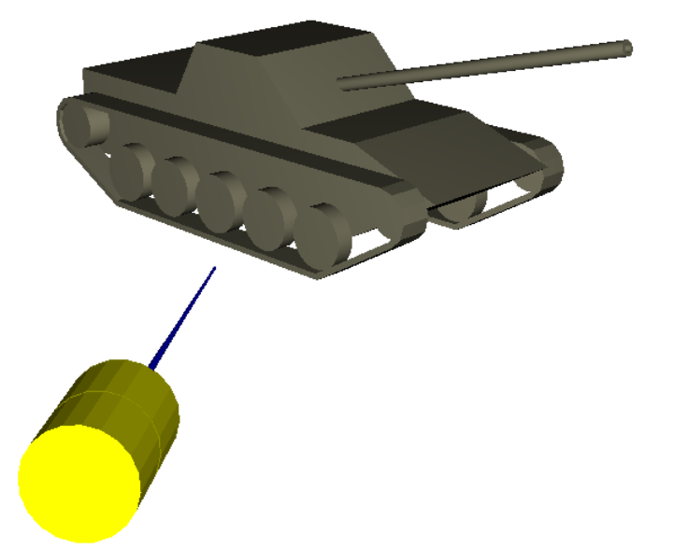
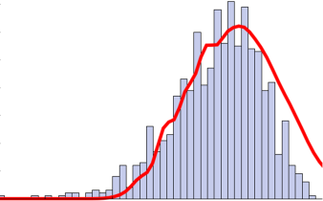
Analyzer
The analyzer can handle M/C simulations that can be parameterized if required.
penetration algorithms
Parameterization
Parameterization
Analyzer
Monte Carlo analyses module

Slide 11
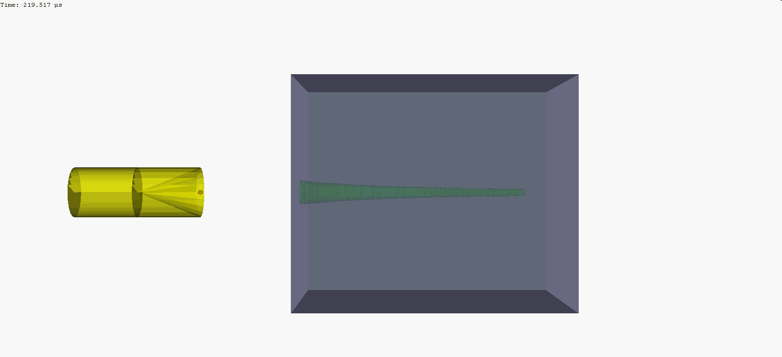
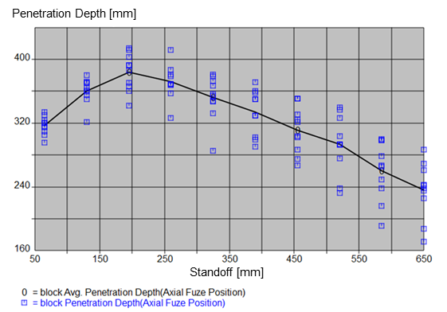
Output
(animated) 3D graphics
diagrams

Slide 12
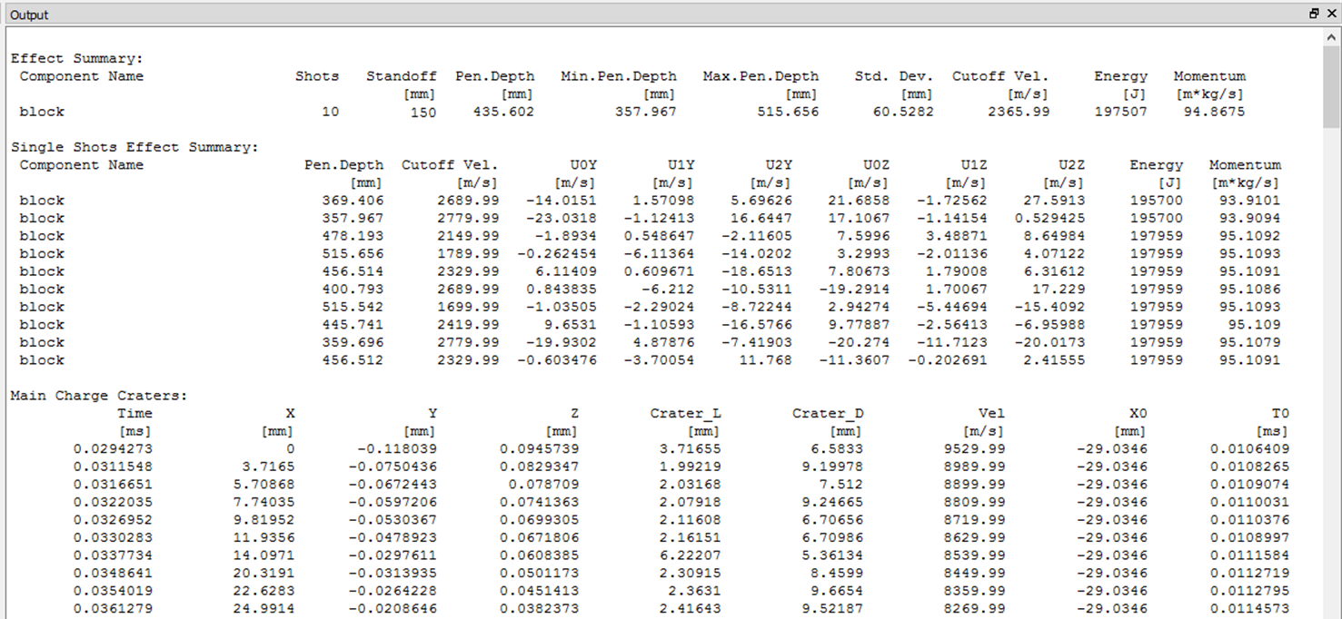
Output
text

Slide 13
Example – Standoff Curve
Determination of a standoff curve for the SC KB44
Hydrocode simulation (SPEED) of jet formation

Slide 14


Example – Standoff Curve
Determination of a standoff curve for the SC KB44
standoff 2 cal. to 20 cal.

Slide 15
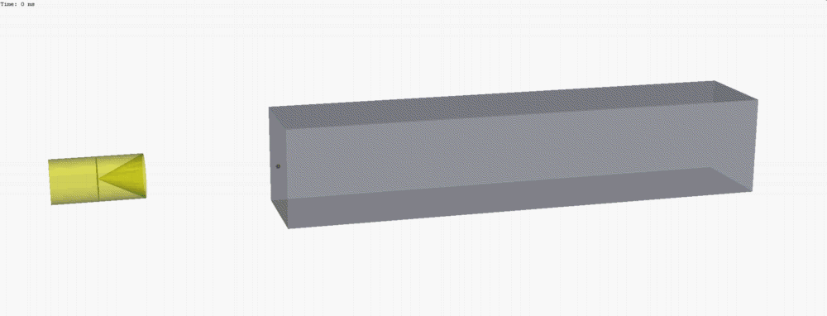

Example – Standoff Curve
Determination of a standoff curve for the SC KB44

Slide 16
Example – Disturbed Jet (Multi-Jet)
Residual penetration performance of SC after fragment impact
Hydrocode simulation (SPEED) of fragment impact and disturbed jet formation

Slide 17
Example – Disturbed Jet (Multi-Jet)
Residual penetration performance of SC after fragment impact
RHA
10 Cal.

Slide 18
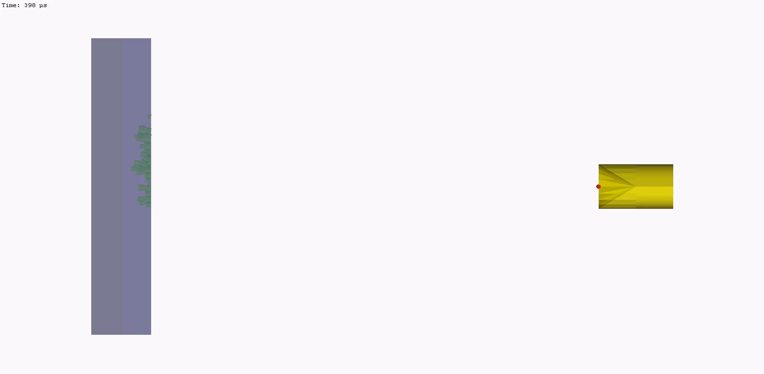
Example – Disturbed Jet (Multi-Jet)
Residual penetration performance of SC after fragment impact
RHA

Slide 19
Optional Modules for Customization
The described basic version is readily available. However, it can be further enhanced / customized by additional modules.
tandem warhead
interfaces for target model import
vulnerability / lethality (V/L) assessment
target features
analysis features
output / visualization features

Slide 20
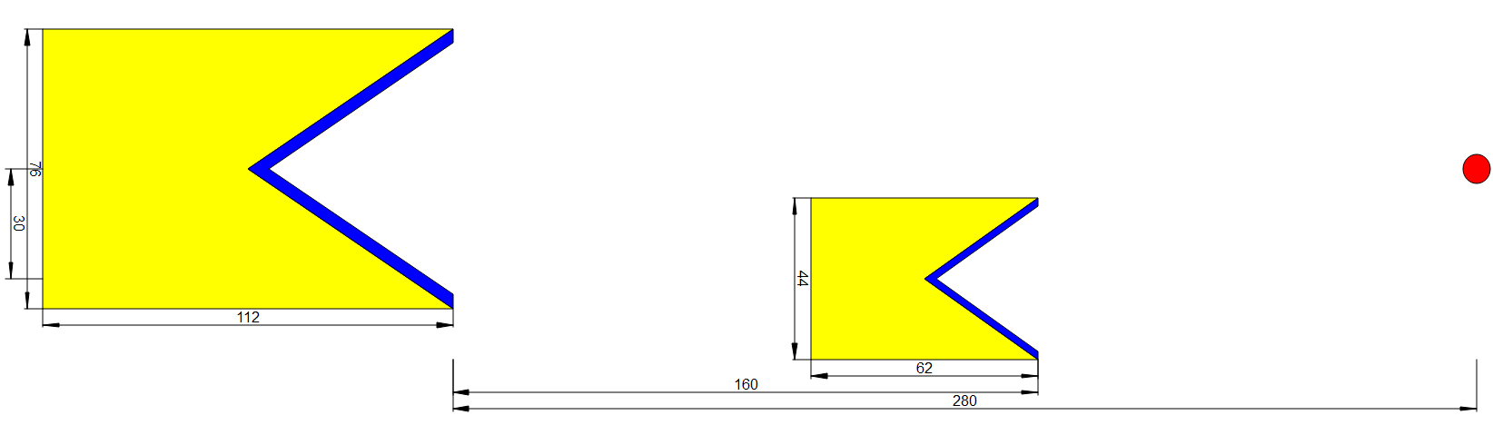
Tandem SC Module
Tandem warheads can be considered with a tandem module.
radial offset
inclination
user-defined delay time

Slide 21
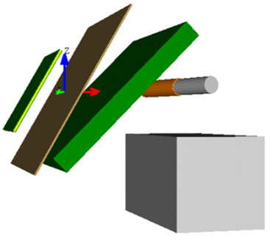
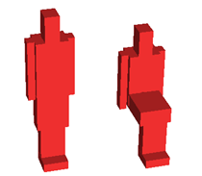
Target Modeling Modules
Target modeling can be enhanced by interfaces for geometry import in different formats or by an increased functionality of the integrated modeler.
BRL-CAD interface
Target Model
STEP interface
k-file interface
enhanced integrated modeler

Slide 22
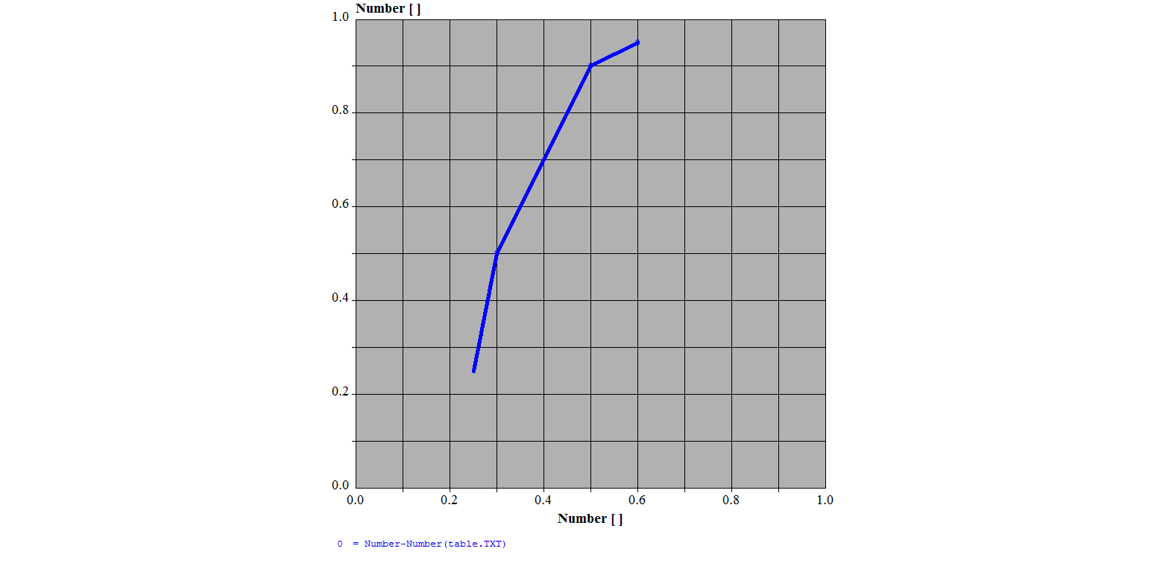
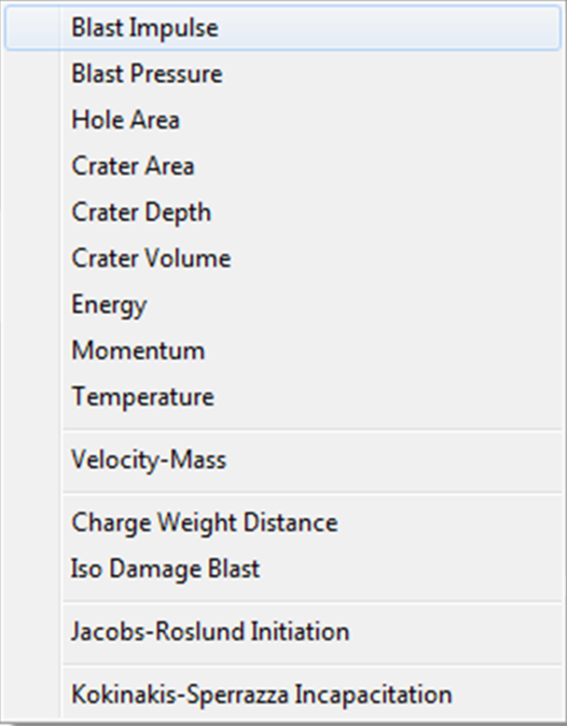
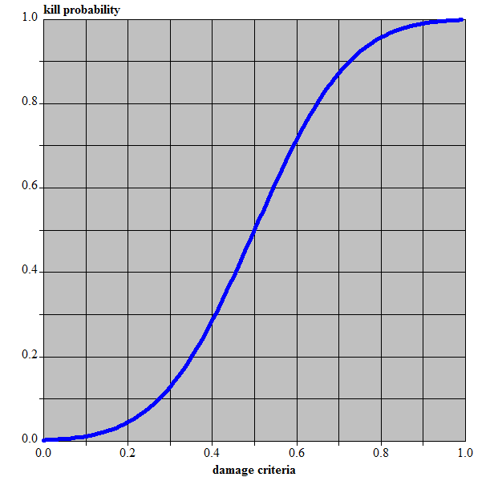
L/V-Module – Target Functional Modeling
The functional model of the L/V module consists of two parts:
Damage criteria definition (Type + Failure Probablilities)
failure probability [-]
failure probability [-]
damage criterion [-]
damage criterion [-]

Slide 23
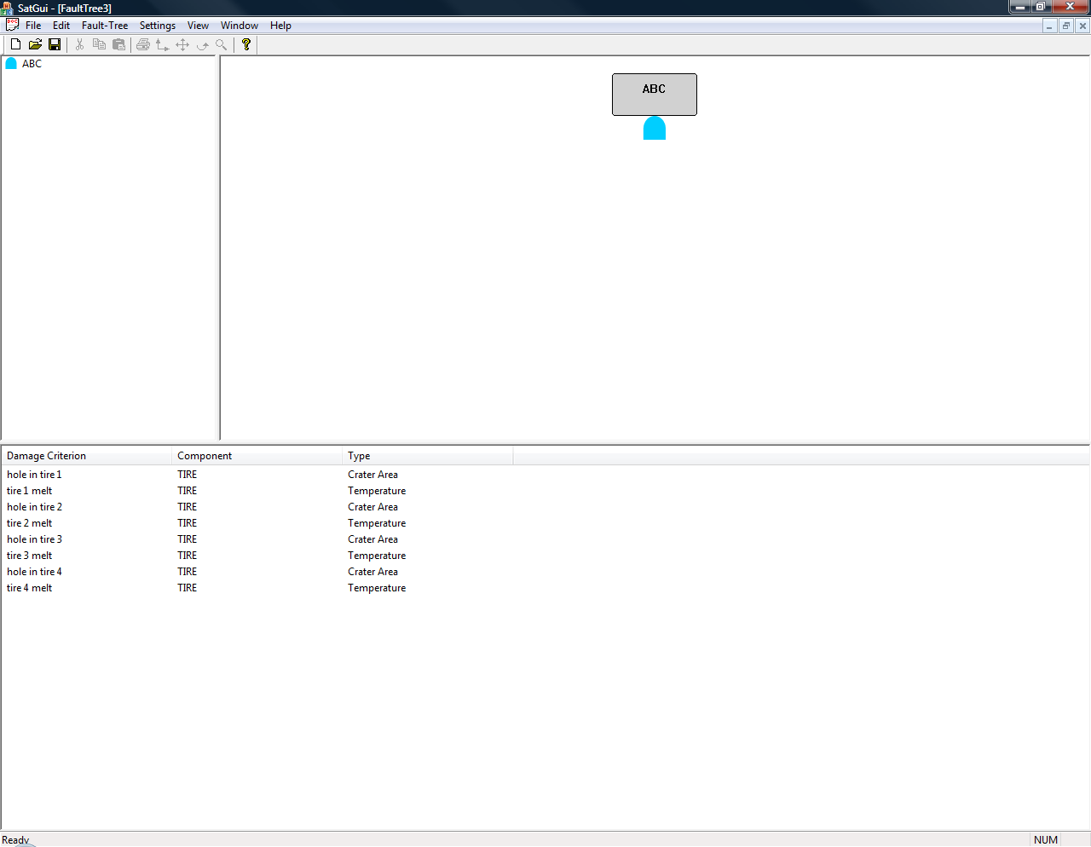
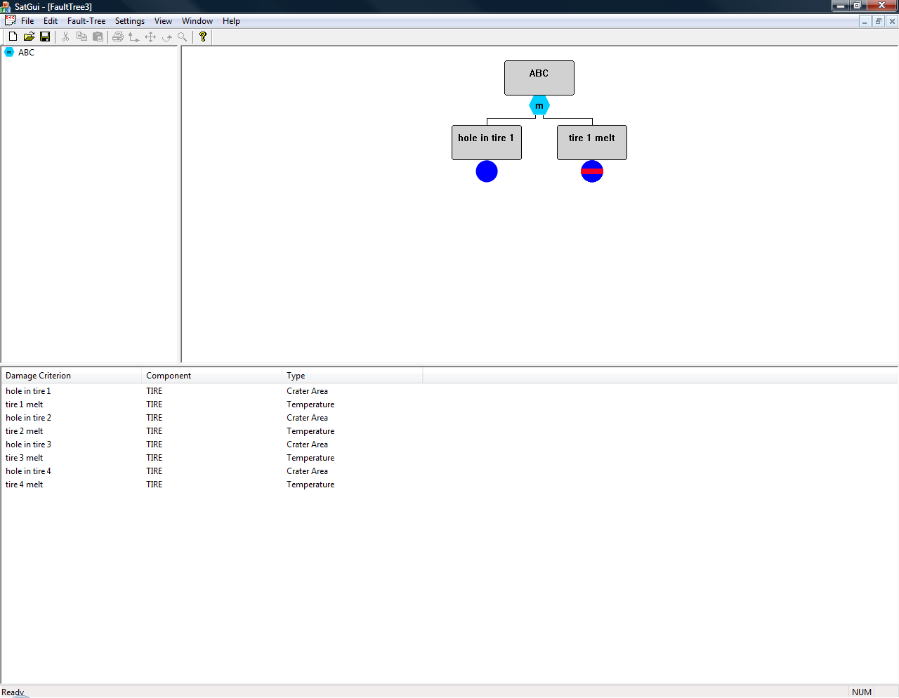


L/V-Module – Target Functional Modeling
The functional model of the L/V module consists of two parts:
Fault Tree
AND
Criterion
OR
Complement
COMBINATION

Slide 24
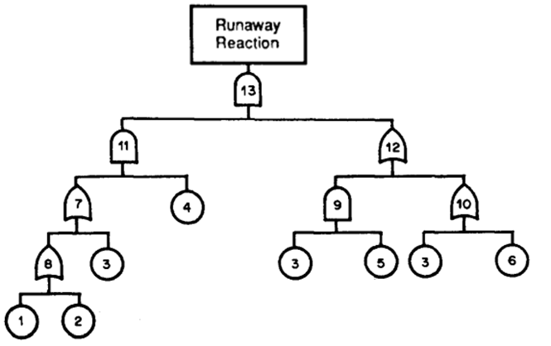
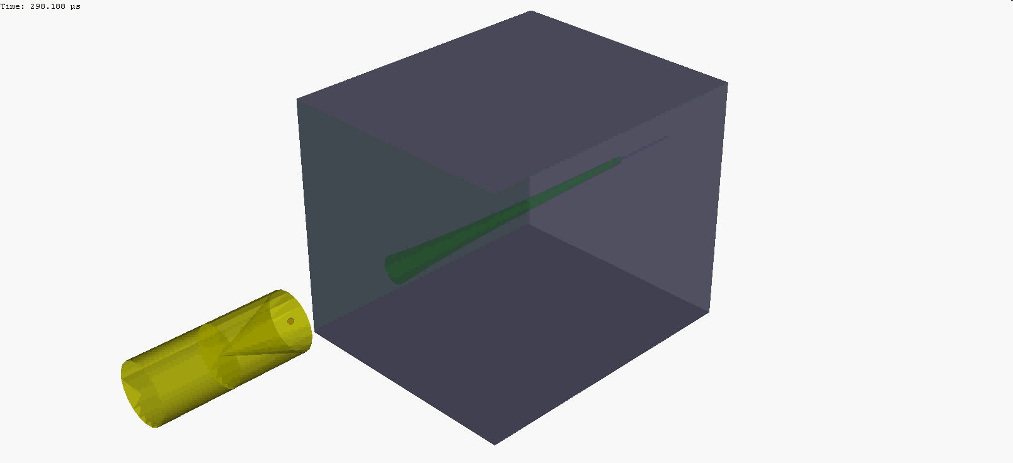

L/V-Module – Fault Tree Processor
The single failure probabilities are combined according to their relationship defined in the fault tree.
…
individual failure probabilities
Analysis result
Fault Tree Processor
statistically independent events
→ direct calculation
statistically dependent events
→ recursive algorithm (Page & Perry)
Kill Probability
P_{k}

Slide 25
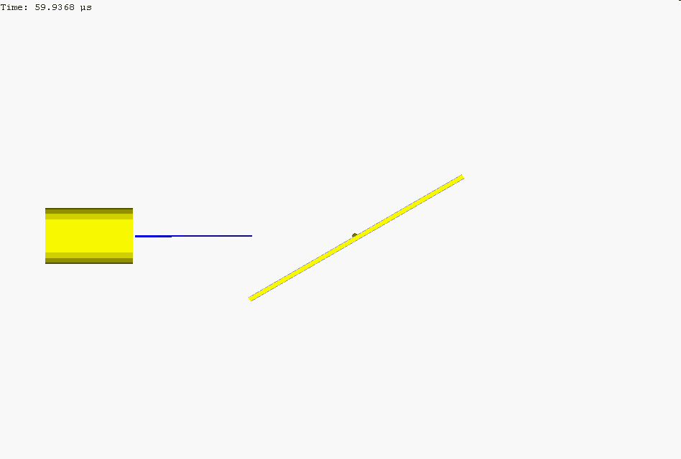
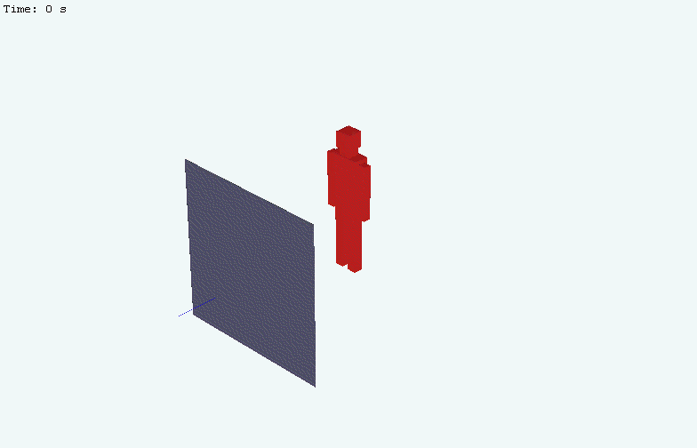
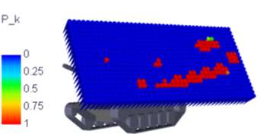
Analyzer Modules
The analyzer can be enhanced to conduct gridded simulations that can be parameterized if required. Add-ons for BAD and ERA are also available.
Analyzer
ERA module
BAD module
gridded analyses module
(vulnerability)

Slide 26
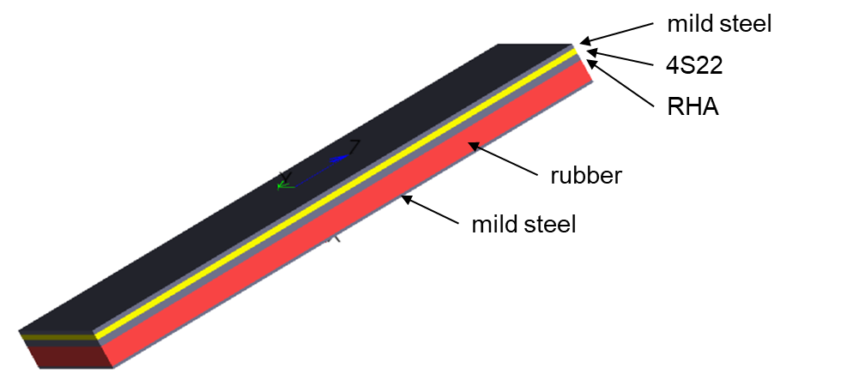
ERA Module
The ERA module allows to model sandwich structures with one explosive layer and an arbitrary number of flyer plate layers.

Slide 27
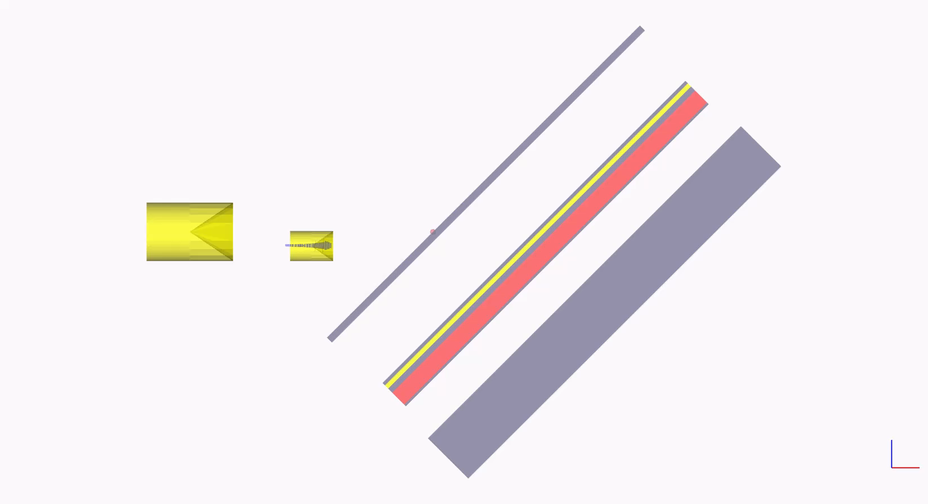
ERA Module
Note: ERA plates are stopped when hitting a target plate (→ no momentum transfer)

Slide 28
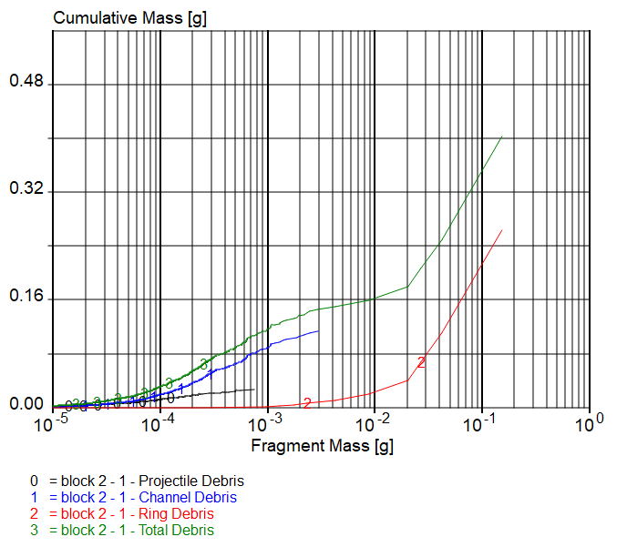
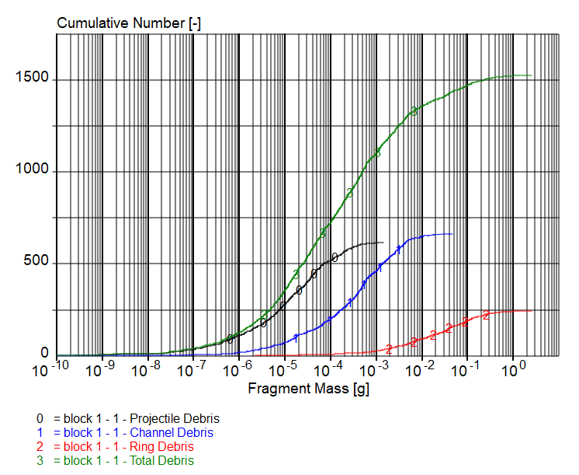
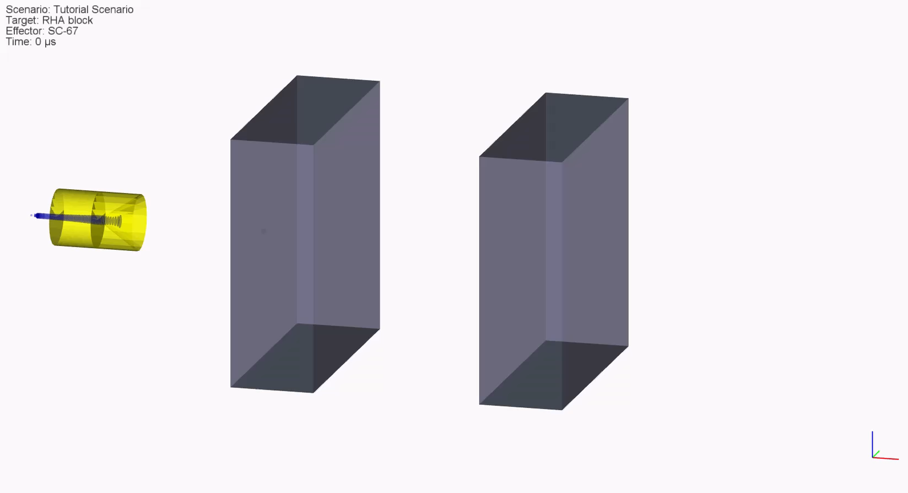
BAD Module
Behind Armor Debris can be fully evaluated:
fragment mass distribution M(m) and N(m)
fragment trajectories
fragment terminal ballistics

Slide 29
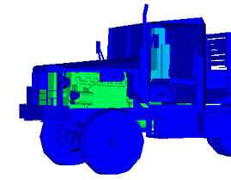
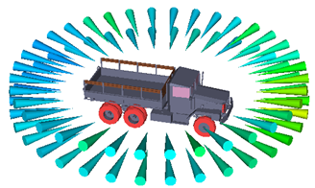
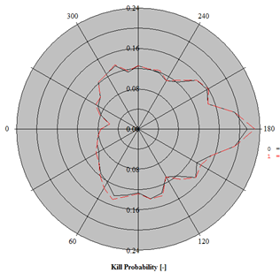
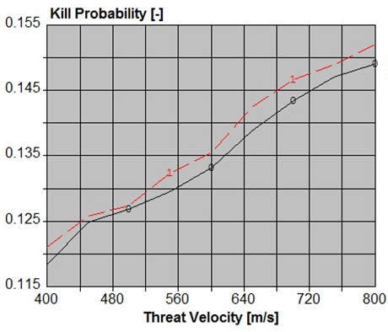
Augmented Output
The output can be augmented according to user requirements:
unidirectional (2D) and multi-directional (3D) graphics
Cartesian and polar diagrams

Slide 30

Summary
The presented shaped charge module of the Modular Analysis Package (MAP) offers a broad variety of features for a customized weapon effects and / or lethality / vulnerability (L/V) code.
A basic version for target modeling, shaped charge definition, scenario setup, analysis and output is readily available, but can also be enhanced and adapted to the specific customer requirements.
Thereby, MAP offers several advantages:
Calculation / analysis algorithms are tested and validated.
Customer-specific new model developments can easily be integrated.
Building up on existing functional modules significantly reduces the project duration for customization.
The modular structure provides the flexibility to include functional extensions to account for future requirements.

Slide 31
Thank You for
Your Attention !

